Slide 1

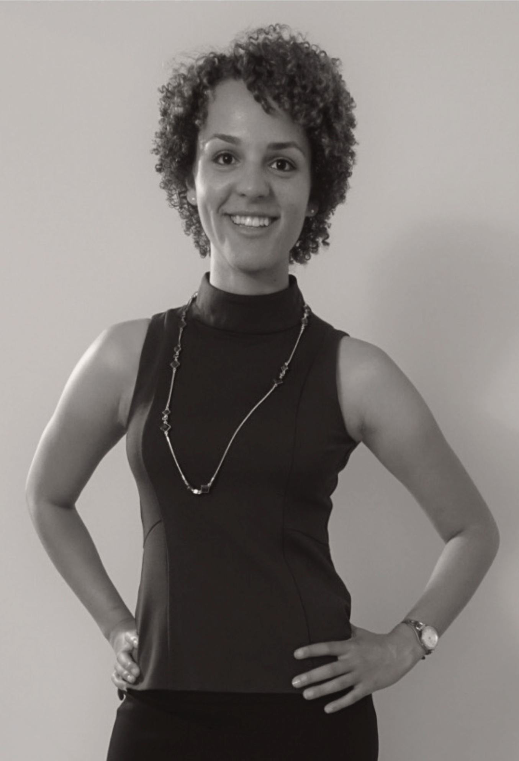

Kaska Miskolczi
Unicorn Designer & Developer
CV.
+1 (208) 789-0671

Slide 2

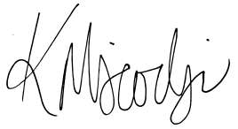

Summary & Education
Arch. Diagrams. Agile Collaboration. Bug Whispering.
CI/CD Pipelines. DevOps SME. SAAS & IAAS.
eCommerce. Headless CMS/ LMS.
App Design & Dev. Web Design & Dev. System Automation. Platform Configs.
Embedded Systems. Microservices Eng. Cyber Security.
Devising creative solutions to complex problems is my shtick.
My blend of artistic insight, critical thinking, and technical prowess, enables me to create engaging media experiences, while solving real- world complex problems for you and your clients.
Over the course of your search for a new team member, I doubt you’ll find another candidate as passionate about designing sustainable software.
Should you wish to connect after reviewing my resume, please do not hesitate to reach out.
Bash/Zsh/Ksh C/C++
HTML/CSS/jQuery. Vanilla JavaScript. TypeScript.
React/AngularJS. D3 & Tableau.
Drupal >=7. Sitecore.
Docker. Terraform. TravisCI/Jenkins. AWS/Azure/IBM. HashiVault.
Üdözlettel,
EDUCATION
Self-Paced, Life
Online & Local Edu
Continued Education
Keeping up with libraries via documentation, guides course certificates, local colleges, etc
Florida Gulf Coast University
Philosophy and Artificial Intelligence, where my research & experience focused on the philosophy of learning/intelligence.
2009 - 2014
Bachelor of Arts

Slide 3


Professional Experiences
Senior Software Architect | Miskolczi Software Consulting
December 2015 - Present (Consulting to avoid corp. conflict of interests)
Working with Clients to design & develop data visualization/administration portals, logistics and supply chain software, cloud integration APIs, and automation structures to assist in the creative and interactive process sequences revolving around the design, development and deployment of cloud-based software, services and similar end-point/transactional technologies.
Worked with clients like Cox Automotive to create and deploy automotive shopping applications in JavaScript and C++, utilizing Node and ReactJS frameworks as well.
Managed infrastructure upgrades, analysis and resolution of end user software utilized in public, private and gov. sector applications with clients like Boeing and AutoDesk.
Developing kernel kexts for Healthcare hardware & legacy 3rd party systems
Responsible for US-CERT CVE findings on behalf of clients like ADP Corp.
Utilizing React, Vue, Ionic, Angular & Node JavaScript libraries to create admin portals with regards to business data analysis, and e-commerce platform tracking engagement.
Translating static software designs into functional prototypes with Vanilla JavaScript, TypeScript, HTML/CSS/jQuery and ReactJS
Creating Docker & Ansible server images for IAAS, microprocessors & data centers for partners
Senior Cloud Security & Design Architect | RelayHealth
July 2018 - November 2018
Major healthcare client consulting contract, created with the intention of helping assist RelayHealth into their migration off-prem legacy HPE non-stop build, to a hybrid MS Azure and AWS cloud environment, with automation of deployments and continuous integration in mind.
Designed and implemented system security and data assurance, and enterprise processes, with best practices tailored for healthcare requirements via HIPPA and Gov.CMS.
Wrote and maintained custom scripts to increase system efficiency and performance time, during installations, configurations of operating systems, for an SLA of 99.9999997%
Implemented network security equipment, including firewalls, two-factor authentication, and antivirus software for networks supporting over 2.5 million users.
Prepared, all documentation and continued grant proposals to support Azure and OpenStack environments, implemented with a front-end design for level II tech implementation.
Senior User Interface Developer | Booz Allen Hamilton
November 2017 - July 2018 (Only left to gain RelayHealth as client, per conflict of interest)
Started off as a user interface developer with CDC and ArcGIS contracts, who would be able to traverse both design and development to create data analysis dashboards for international datasets into D3, GraphQL and JS applications, primarily in the government sector. After a couple months of creating development workflows with CI/CD pipelines for our micro-embedded systems, I successfully hacked into the Department of Homeland Security’s DNSSEC and government-wide service platform, landing me a role more specified in cyber security for their micro-services and cloud containers.
Maintained strict budgetary and scheduling guidelines to satisfy clients with high-quality, targeted designs with on-shore and off-shore development teams...

Slide 4


Continued from previous page...
Designed and executed security measures such as firewalls, MFA, block-chain encryption, and SEIM logging with scripted alerts.
Planned and engineered RESTful web services, consuming Tableau outputs into JSON and designed with D3JS, to manipulate dynamic datasets for CDC's and ArcGIS datasets.
Conceived and built optimized mobile and web applications in HTML, CSS, PHP, .NET, C# with Razor, vanilla JavaScript, Angular and NodeJS.
Conceived and built optimized mobile and web applications in HTML, CSS, PHP, .NET, C# with Razor, vanilla JavaScript, Angular and NodeJS.
Conceived and built optimized mobile and web applications in HTML, CSS, PHP, .NET, C# with Razor, vanilla JavaScript, Angular and NodeJS.
Software Developer | FierceMarkets
February 2017 - November 2017
BigData, high performant and largely scalable marketing and engagement platform provider contract, wherein I was hired to perform recursive testing, debugging, automation of their continuous deployment model and create a headless Drupal CMS based publishing environment from wireframe to deployment in stage before off-shore team takes to production.
Collaborated with developers and performance engineers to enhance supportability and identify performance bottlenecks, throughout all stages of our development lifecycle.
Revised, modularized and updated old code bases to modern development standards, reducing operating costs 36%.
Led group of 15 engineers in design and development of headless CMS of Drupal via Bash Scripting, Drush, and AWS solutions.
Orchestrated efficient large-scale software deployments, including testing features and correcting code.
Performed regression, unit-blocked and system-level testing to verify software quality and function prior to release.
Compiled specifications, dev. methods and other scripting modifiers for headlessCMS project into technical manuals for team.
Interfaced between high-value customers and junior developers, encouraging use of client feedback in software updates.
Webmaster & 2D/3D Animator | Florida SouthWestern State College
April 2014 - November 2016 (Concurrent with 1st major side-contract in Idaho)
Webmaster for all four college campuses, post transitional name-change from Edison State College and major Presidential scandal. Rehabilitated community image with re-designed branding & marketing strategy/assets. Developed 3D campus mapping software with 2D drone tracking for new sports arena games. Finished tenure with ADA compliance regulation automation platform, which I developed while managing two junior developers in a combination of a headless code-igniter CMS base, cakePHP blend with vanilla JavaScript, Puppet, C++, etc.
Gathered and synthesized business requirements, as team representative in executive meetings, discussing defining and translating user requirements into project designs and implementation plans, exceeding aggressive deadlines.
Built user interface, data visualizations and designed to eliminate bugs and improve overall user experience, resulting in 27% increase of enrollment and SEO/SEM click-through rates.
Spearheaded and implemented use of Git and Mercurial version control across all four campuses for design and development.
Created powerful headless Content Management System built with HTML, CSS, PHP, vanilla JavaScript, C++, MySQL, Oracle Cloud, AWS, Puppet, and OpenStack solutions, to serve as interface for client.
Automated consumption of Oracle and SAP data outputs, by custom built RESTful and SOAP micro-services to manipulate dynamic datasets with multiple entry and touch points.

Slide 5
Sitecore Webmaster | Abbey Carpet & Floor
December 2013 - November 2014
Created major headless CMS with Sitecore .NET framework as base and e-commerce platform for all 2000+ retail partners across the continental USA. Headless CMS platform created, still in use today across both corporate and individual franchise retail locations.
Liaised with customers to determine pre-development design specifications, including finished design parameters, implementation deliverables and to meet strict deadlines.
Built user interface, data visualizations and designed overall user experience, resulting in 67% increase in sales and100% improvement in ADA/WCAG compliance.
Delivered drastic improvements to new headless CMS framework, developed off a Sitecore distr., still in use today, leading to 97% efficiency boost, with emphasis on realtime API integrations with other big-box retailers across the continental USA.
Wrote server-side and client-side code for C# and .NET and .NET Core projects using Bash Scripting, PHP, HTML, CSS, and JavaScript, specifically with Angular and Node frameworks.
Created detailed performance KPIs and analytical reports on client website strategies, honing user demographics and statistics using Google Analytics and custom vanilla JavaScript automation.
Aircraft Weight & Balance Alg. Engineer | United Parcel Service
September 2012 - February 2014 (Left to finish remaining school term, per 3am start time)
Webmaster for all four college campuses, post transitional name-change from Edison State College and major Presidential scandal. Rehabilitated community image with re-designed branding & marketing strategy/assets. Developed 3D campus mapping software with 2D drone tracking for new sports arena games. Finished tenure with ADA compliance regulation automation platform, which I developed while managing two junior developers in a combination of a headless code-igniter CMS base, cakePHP blend with vanilla JavaScript, Puppet, C++, etc.
Identified issues with software components and isolated regulation faults prior to implementing corrective actions.
Interpreted aircraft specifications, diagrams and blueprints and compared information to completed work verify quality and assess vehicle integrity.
Assisted dismantling and repairing of reconditioned aircraft structural parts and hangar equipment to repair malfunctions and enhance functionality, performance and durability.
Adhered to strict safety procedures and protocols when creating automated logarithmic functions via Binary, ASM, C/C++ libraries, protecting both flight personnel and software equipment.
Cultivated vast knowledge of aircraft systems by attending training workshops, enhancing functionality of systems, automating the checkout control features of our Boeing cargo aircraft and implementation of expertise in routine work and special projects.
Saved USP over $2 million by implementing cost-saving initiatives that addressed long- standing problems related to our incremental weight and balance control system.
Check me out on LinkedIn | linkedin.com/in/batmanwgd
For More information on other roles and certificates
Schedule an Appointment with Me | calendly.com/batmanwgd
In order to get on my calendar for calls, meetings or anything else :)
Professional Experiences

Slide 6

Kaska Miskolczi
Unicorn Designer & Developer
Üdvözlettel.
Taking Clients.
Mondays through Thursdays 8:30am to 4:00pm
Atlanta, Georgia
Primarily looking for full-time roles with a collaborative team & longevity.
@batmanwgd kmiskolczi@outlook.hu
Design Portfolio.
https://kaska.myportfolio.com
:)
+1 (208) 789-0671

